Slide 1
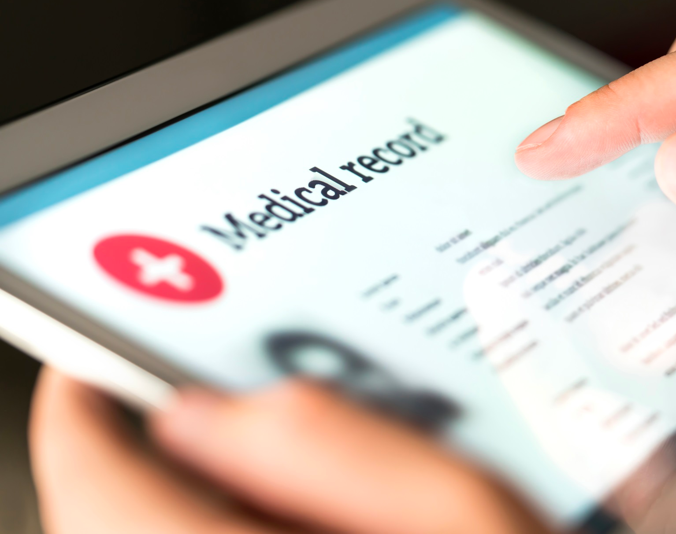
Patient Based – Medical Record Database
Group 2
Lance Zeng, Huidi Wang
Yi Shen, Zhirong Lin

Slide 2

1 Problem Statement - Motivation
Medical Record System:
Providing accurate, up-to-date, and complete information about patients at the point of care
Connect patients to local, accessible healthcare providers
Improving interaction and communication between healthcare providers and patients

Slide 3

1 Problem Statement - Challenge
Medical Record System:
Currently, hospitals and insurance agencies exercise a lot of control
Medical data is distributed across multiple sources
Our hope is that this data management system will create a more transparent system, and simplify what is an important aspect of a patient’s life.

Slide 4
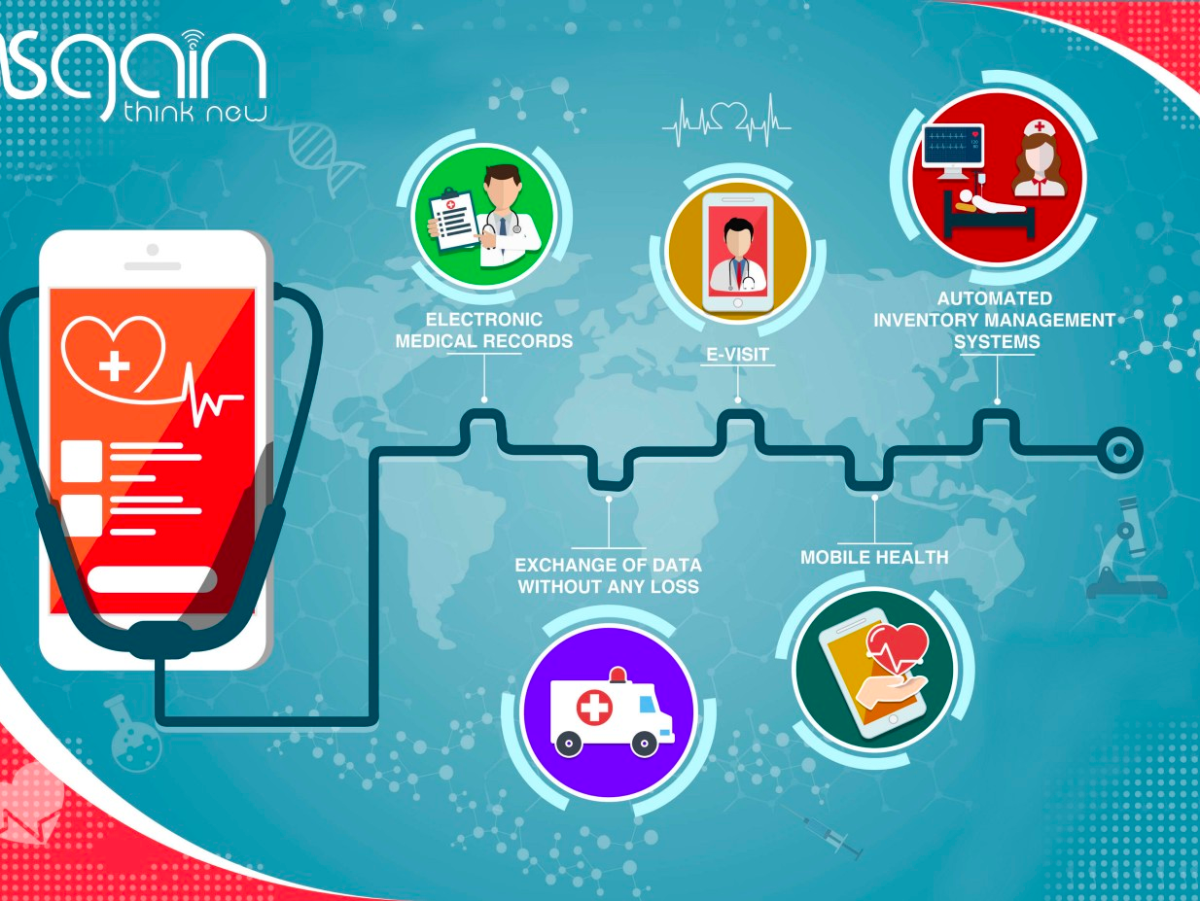
2 Project Description
Ultimate Goal:
Building a patient-centric healthcare community that empowers patients to take their healthcare into their own hands
Use Cases:
Secure and track user medical records
Locate the nearest hospitals/clinics accepts the user’s insurance
Connect with others who experienced similar affliction
Notes:
1. U.S use only
2. Doctor & Nurse can’t work for different clinic – improve in future development

Slide 5
Patient Visit
Center Hub of our application, defined by a patient-doctor pair
3 Database Design – Data Dictionary
Treatment
The purpose of the visit, including general checkup to physical therapy, and if has a prescription for this treatment
Person
Includes basic and personal patient information, includes Name, Address, Contact information, Gender and Insurance
Hospitals/Private Clinics
Key resource for patient to explore surrounding medical places and doctors.
Drug
Store drug ID and drug name. Relates to treatment table
Doctors
Information for each doctors
Insurance
Insurance record of patient includes insurance company’s and ID.
Nurses
Information for nurses
Diseases
A lookup table that consists of diseases and conditions

Slide 6
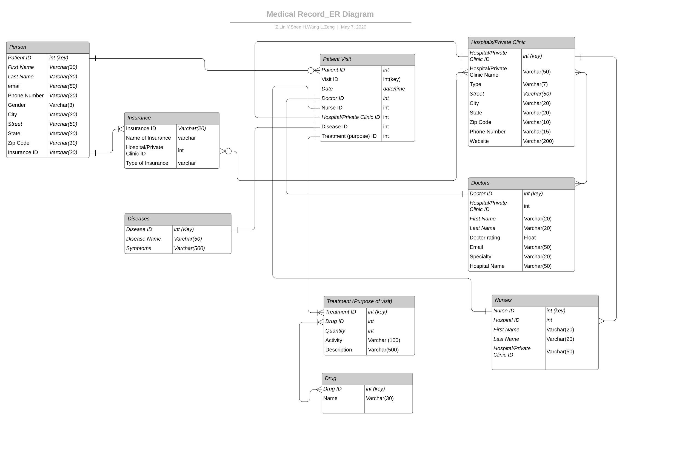
3 Database Design – ER Diagram

Slide 7

4 User Interface
Use Cases:
Secure and track user medical records
Locate the nearest hospitals/clinics accepts the user’s insurance
Recommend nearby doctors for users
Connect with others who experienced similar affliction
Please Watch Our Live Demo!
http://localhost:5000/homepage.html

Slide 8
5 Discussion and Future Improvement - Existing Challenge
Phase I (This Version)
Limitation
US. based Only
Each doctor and nurse only work for one hospital/clinics
Data structure
Treatment - Drug table ( one to multiple connection) lead to confusion in visit presentation in front end design.
Notes:
In order to simplified our database structure, we limited our application US only and assume each doctor and nurse only work for one hospital

Slide 9
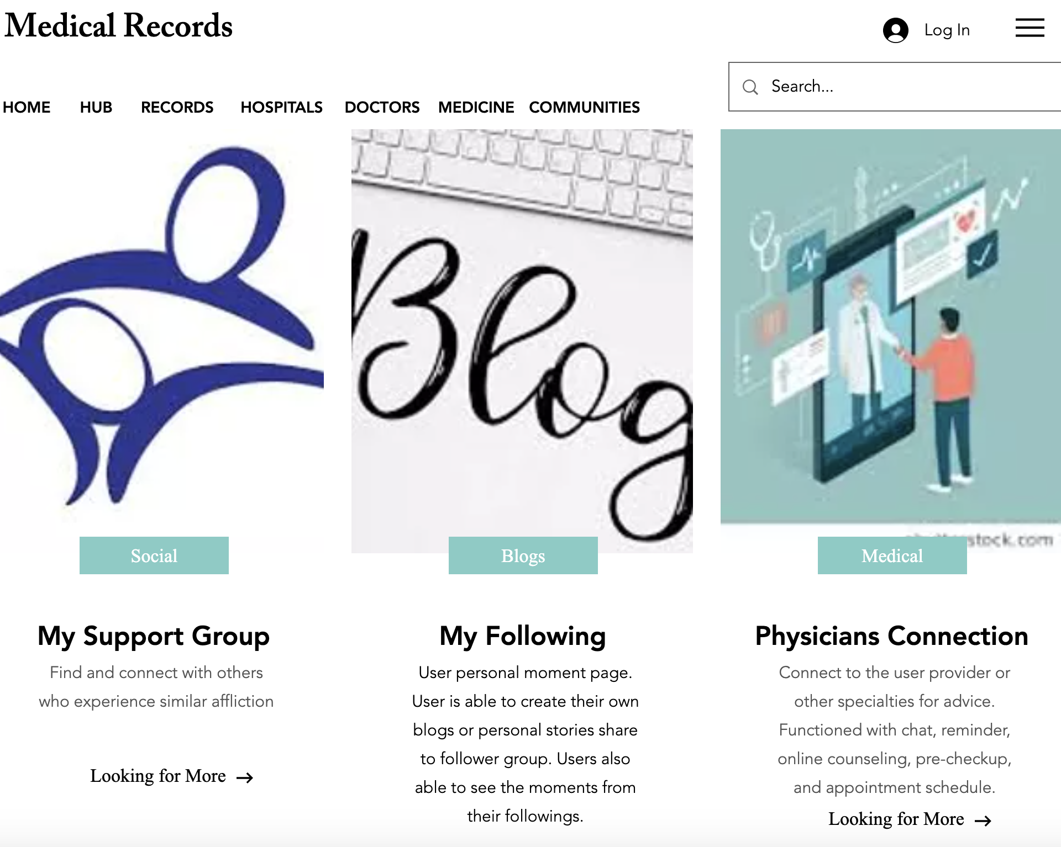
5 Discussion and Future Improvement - Expansion
Phase II
Data struction
Rethink Treatment to Drug table
Doctor and Nurse can work more than one hospital
Link Drug table to Disease table
Expansion
User is able to locate hospitals/clinics and doctor which can accept their insurance AND speciality
Blog interaction
Physicians connection
Adopt more countries to our medical system

Slide 10


Questions & Comments?
Group 2 : Lance Zeng, Huidi Wang, Yi Shen, Zhirong Lin

